Slide 1



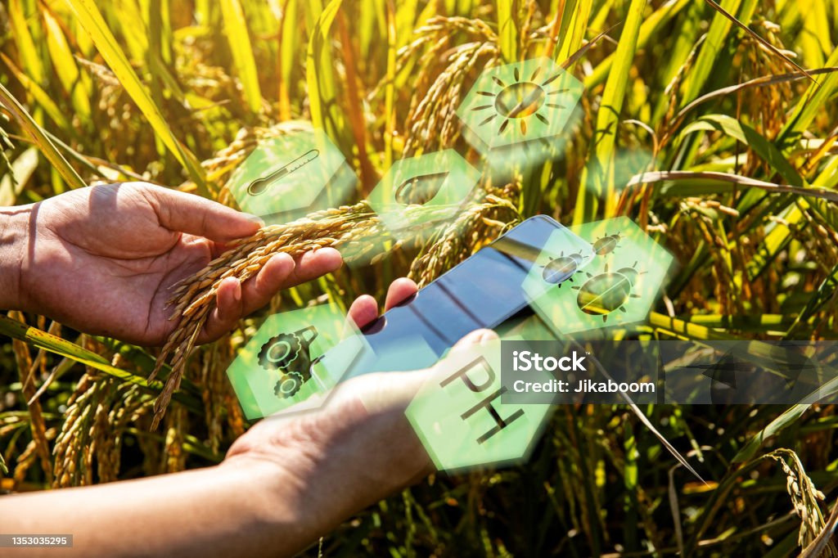

PRINCE DR K VASUDEVAN COLLEGE OF ENGINEERING AND TECHNOLOGY
SUSTAINABLE FARMING THROUGH SMART WATER USE
Guided by :
Mrs : M Sindhu
Assistant Professor
presented by:
M.Abinaya
A.Balaji
E.Barkavi
Ninu Susan Abraham
S Ja .Saai krahanth
CHANAKYA FELLOW SHIP

Slide 2
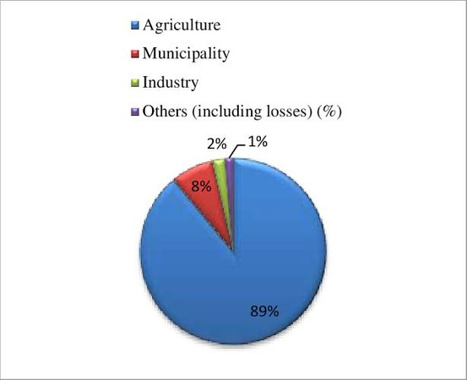
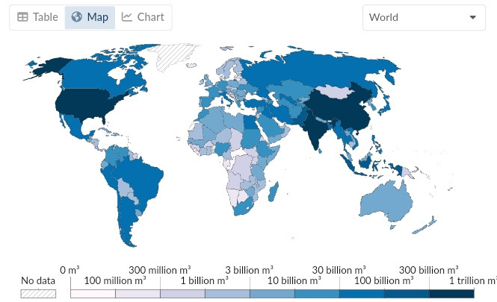
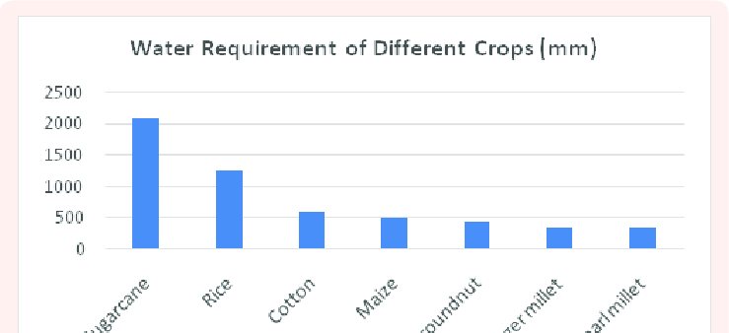
Challenges in Indian Agricultures:
India’s leading crops and their water consumption
Global water withdrawal:
03
Global: 70% freshwater for agriculture.
India: Over 90% for agriculture.
Flood irrigation common, wasteful.
Sugarcane:
High water consumption
Major Indian crop.
Sugarcane farming in India uses about 2 lakh litres of water pt .
However, water-saving methods have saved an estimated 60 million litres between 2019 onwards
06
07
Data source: Food and Agriculture Organization of the United Nations (via WorldBank) – Learn more about this data
OurWorldInData.org/water-use-stress | CC BY

Slide 3


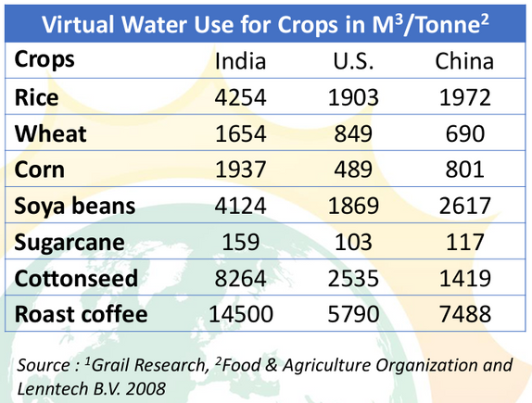



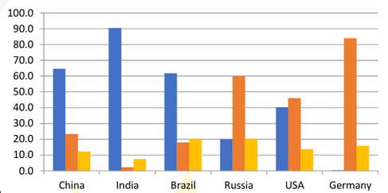




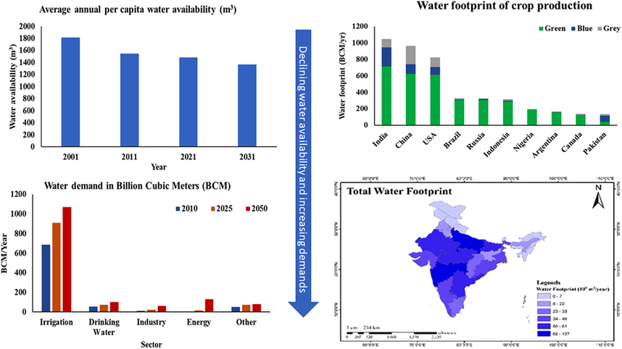



USAGE OF WATER IN INDIAN
AGRICULTURE
01
Rice, Wheat, and Sugarcane constitute 91% of crop production in India,
India uses about 688 M3 of water for agriculture every year, which is the second highest in the world
02
03
Irrigation water use accounted for 83% of the total water use in 1997, estimated to go down to 73% by 2025 under the high-demand scenario
Agriculture accounts for 90% water use and 17.6% of the total GHG emissions in India
04
Data Source:“Agricultural Statistics 2022” published by the Government of India4.

Slide 4






Introducing our Water Management System
Application for farmers, IoT device with humidity sensor.
Optimal
water usage
Aim:
Crop type
1. Application and IoT device development.
2.Data collection: crop type, area, soil moisture, weather.
3.Machine learning generates usage recommendations.
4. Goal: reduce water wastage.
5. Enhance sustainability and cut costs.
6. Mitigate natural calamity risks.
7. Optimizing water usage in agriculture.
Machine learning algorithm
Land Area
Optimal
irrigation type
Soil Humidity
Current Weather
Dataset

Slide 5
Introducing our Water Management System
Application for farmers, IoT device with humidity sensor.
Optimal
water usage
Crop type
The components:
soil moisture sensors
crop type
land area
current weather.
optimization of water usage
Machine learning algorithm
Land Area
Optimal
irrigation type
PROPOSED SYSTEM
Soil Humidity
Sensor integration
Data analysis and decision making
precision integration techniques
Fertigation Integration
Remote monitoring and controls
Water Recycling and Rainwater harvesting
Training support
Current Weather
Dataset

Slide 6


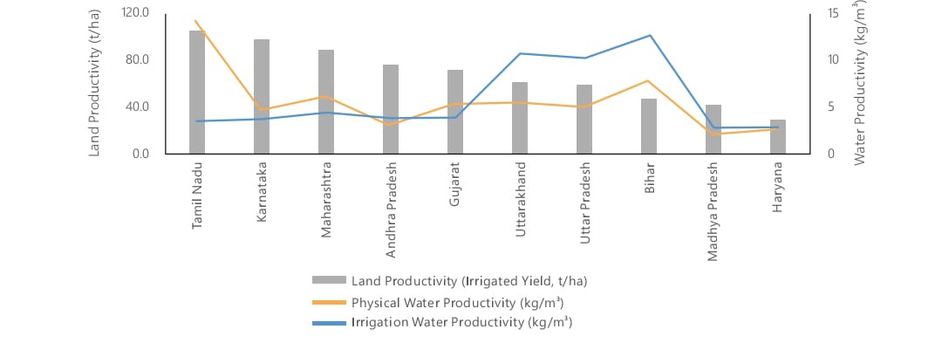
Benefits of Water-Smart Farming
Positive Impact:
Efficient water usage leads to higher crop yield, reduced water wastage minimizes environmental impact, and cost savings for farmers mitigate natural calamity risks.
For Farmers:
Boost Profits (minimized crop losses, better yield).
For the Nation: Economic Gains (reduced water wastage, GDP growth).
Statistical Data:
Before implementing our solution: India’s agricultural exports deplete an equivalent amount of irrigation water permanently.
After implementing our solution: Reduced water wastage positively impacts crop yield and environmental sustainability.
IMPROVE THE GROWTH OF NATION.

Slide 7

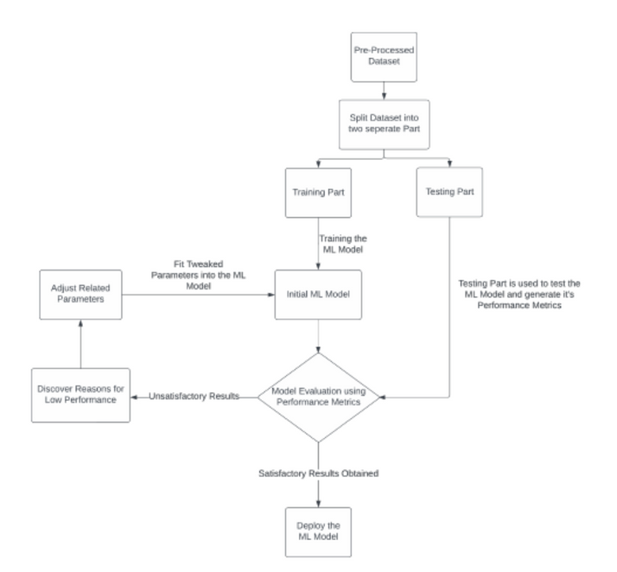
Machine Learning Algorithms:
Logistical Regression:
Flow chart of ML Model
Interpreteblity in agricultural context
Statistical Rigor for crop management
Efficiency in capturing Agricultural Relationships
Feature importance for precision making
Decision support sustainable agriculture
Random Forest:
High Accuracy
Robustness to Overfitting
Non-linearity
Handles Large Datasets
Feature Importance:
Scalability
Optimal water usage

Slide 8
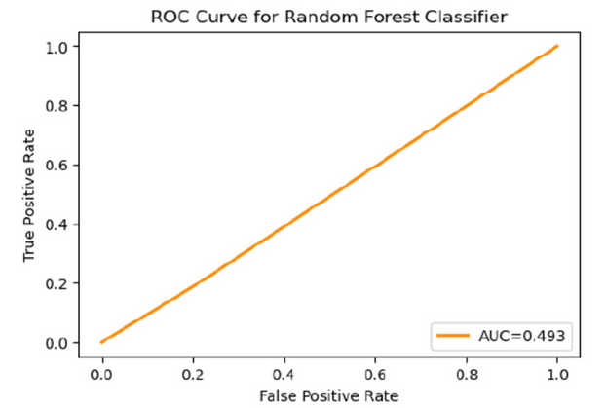
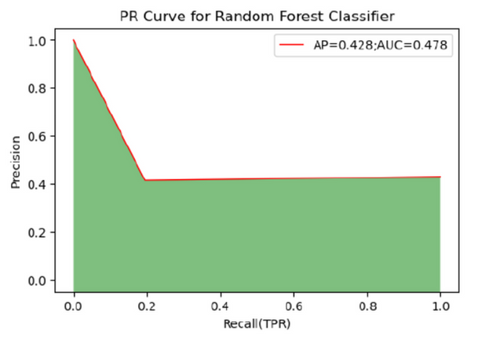
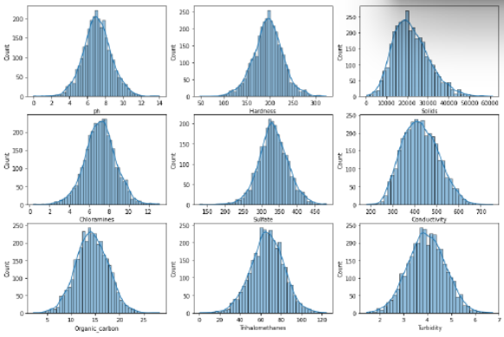
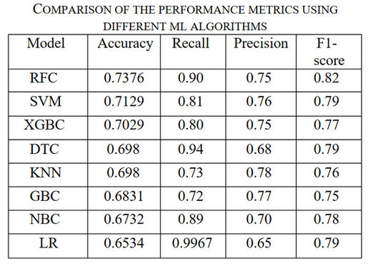
Why we use Random Forest Algorithm ?
Comparision among RFC
AUC - ROC of RFC
AUC - PR of PR
Data Prepocessing
ATTRIBUTES FOR THE CALCULATION OF PERFORMANCE METRICS AMONG THE PROPOSED ML ALGORITHMS
The Area Under the Receiver Operating Characteristic Curve Of Random Forest Classifier (RFC)
The Area Under the Precision-Recall Curve of Random Forest Classifier (RFC)
Distribution plot of 9 attribute after data processing

Slide 9


FUTURE IMPLICATIONS
Long term implications
Scalability
Mitigating climate change impact
COLLABRATORS
Farm Guru Agritech
(knowledge sharing)

Slide 10

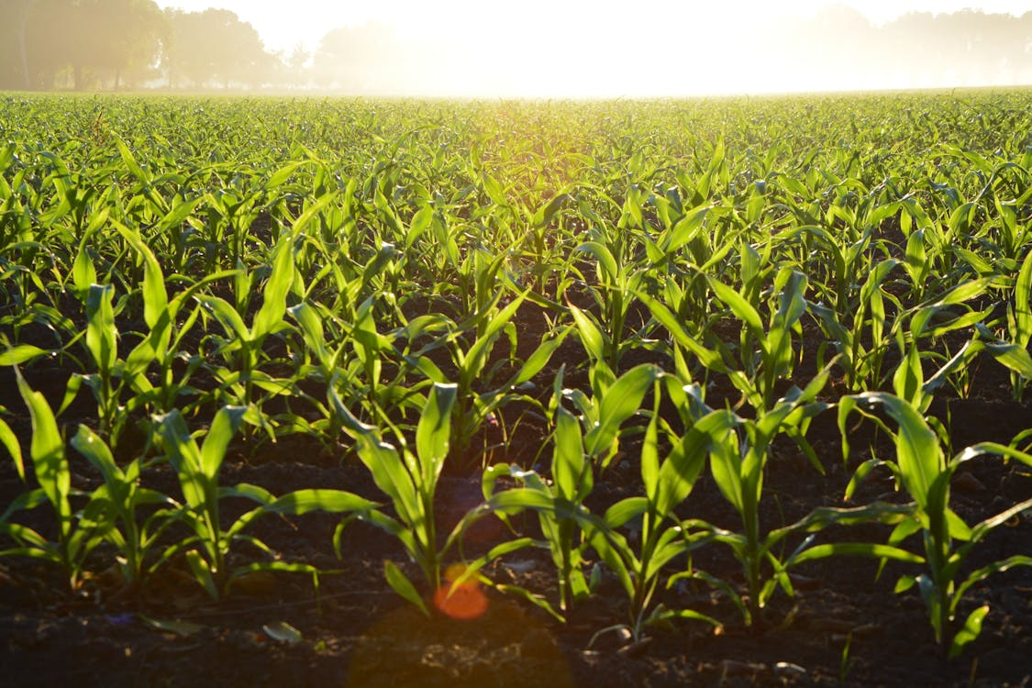














Month 9
Scale-up planning
Month 7-8
Analysis and optimization
Timeline
Month 4-6
Pilot project implementation
Month 1
Project initiation

Slide 11


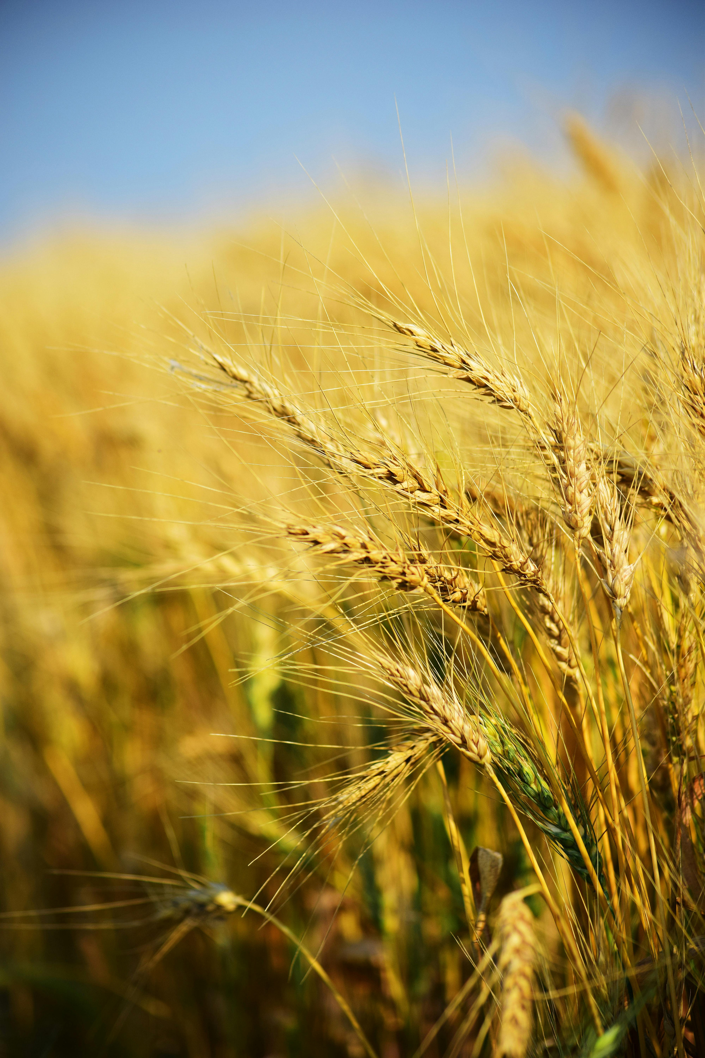


Prince Dr K Vasudevan College of Engineering and Technology
THANK YOU

